Slide 1



CODE CUBICLE 2.0: TEAM ALGO ASSASSINS
MY RESEARCH PAL
THIS IS WHERE YOU RE-SEARCH YOUR RESEARCH.
RECOMMEND
WRITE
REVIEW

Slide 2
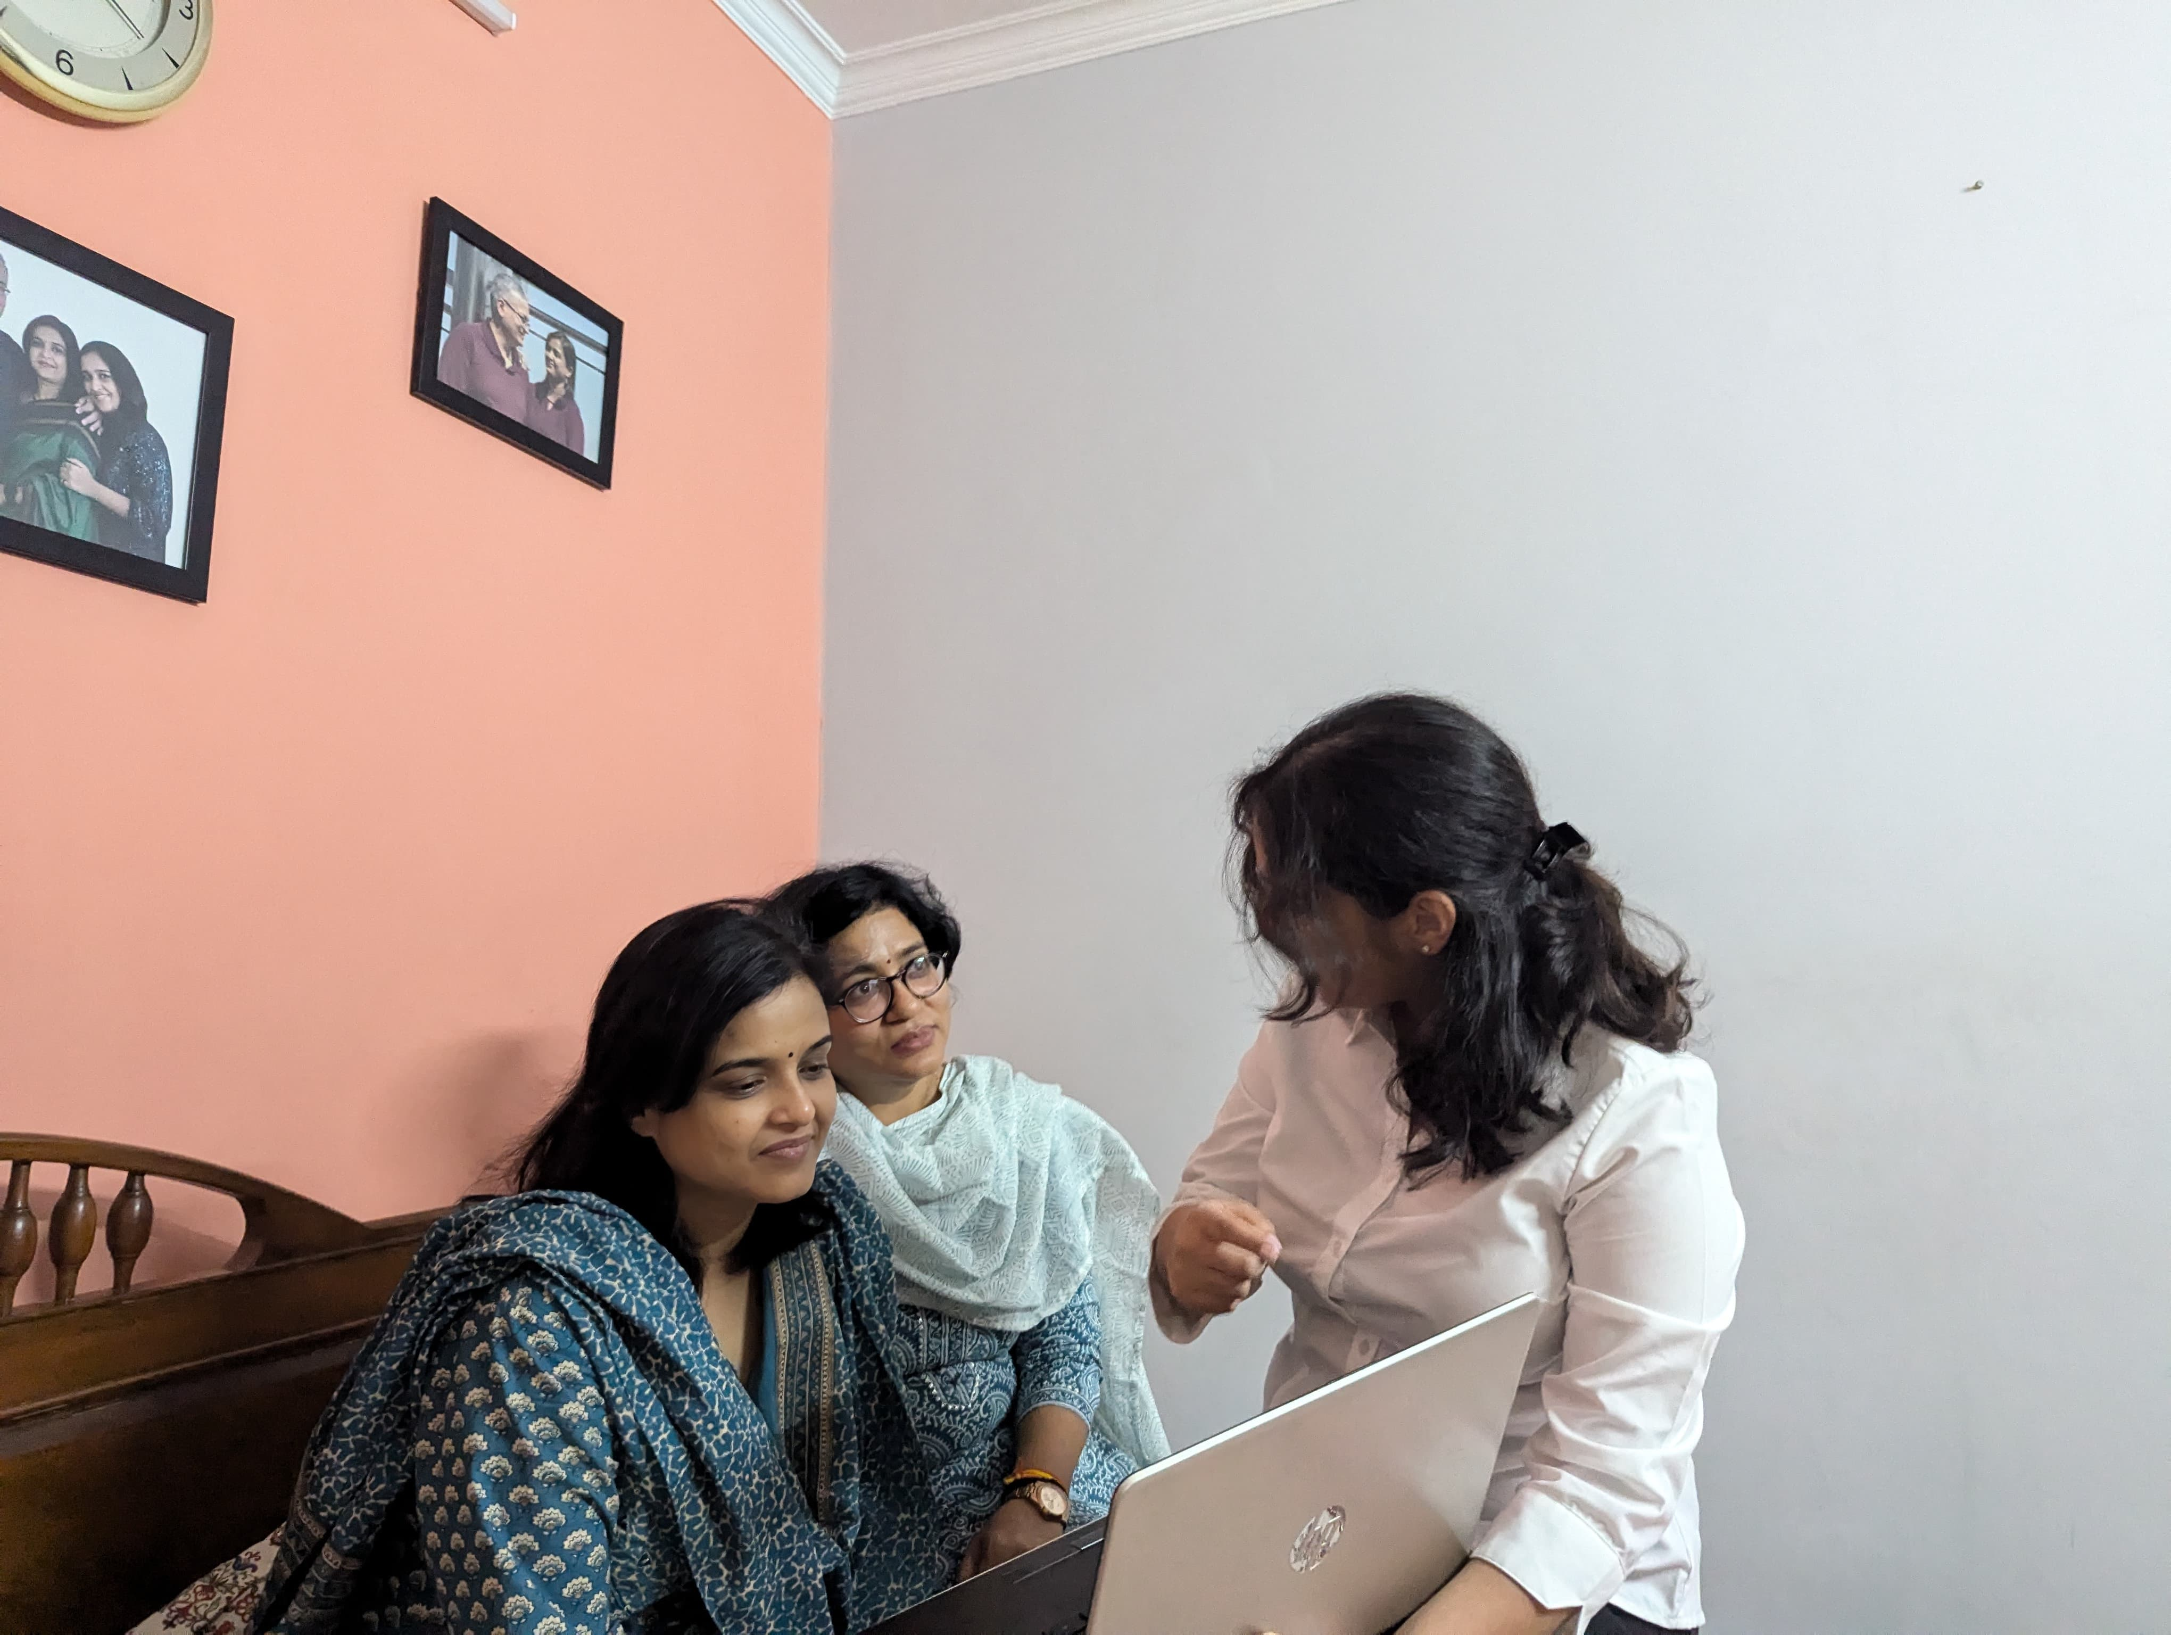

BACKGROUND

Slide 3
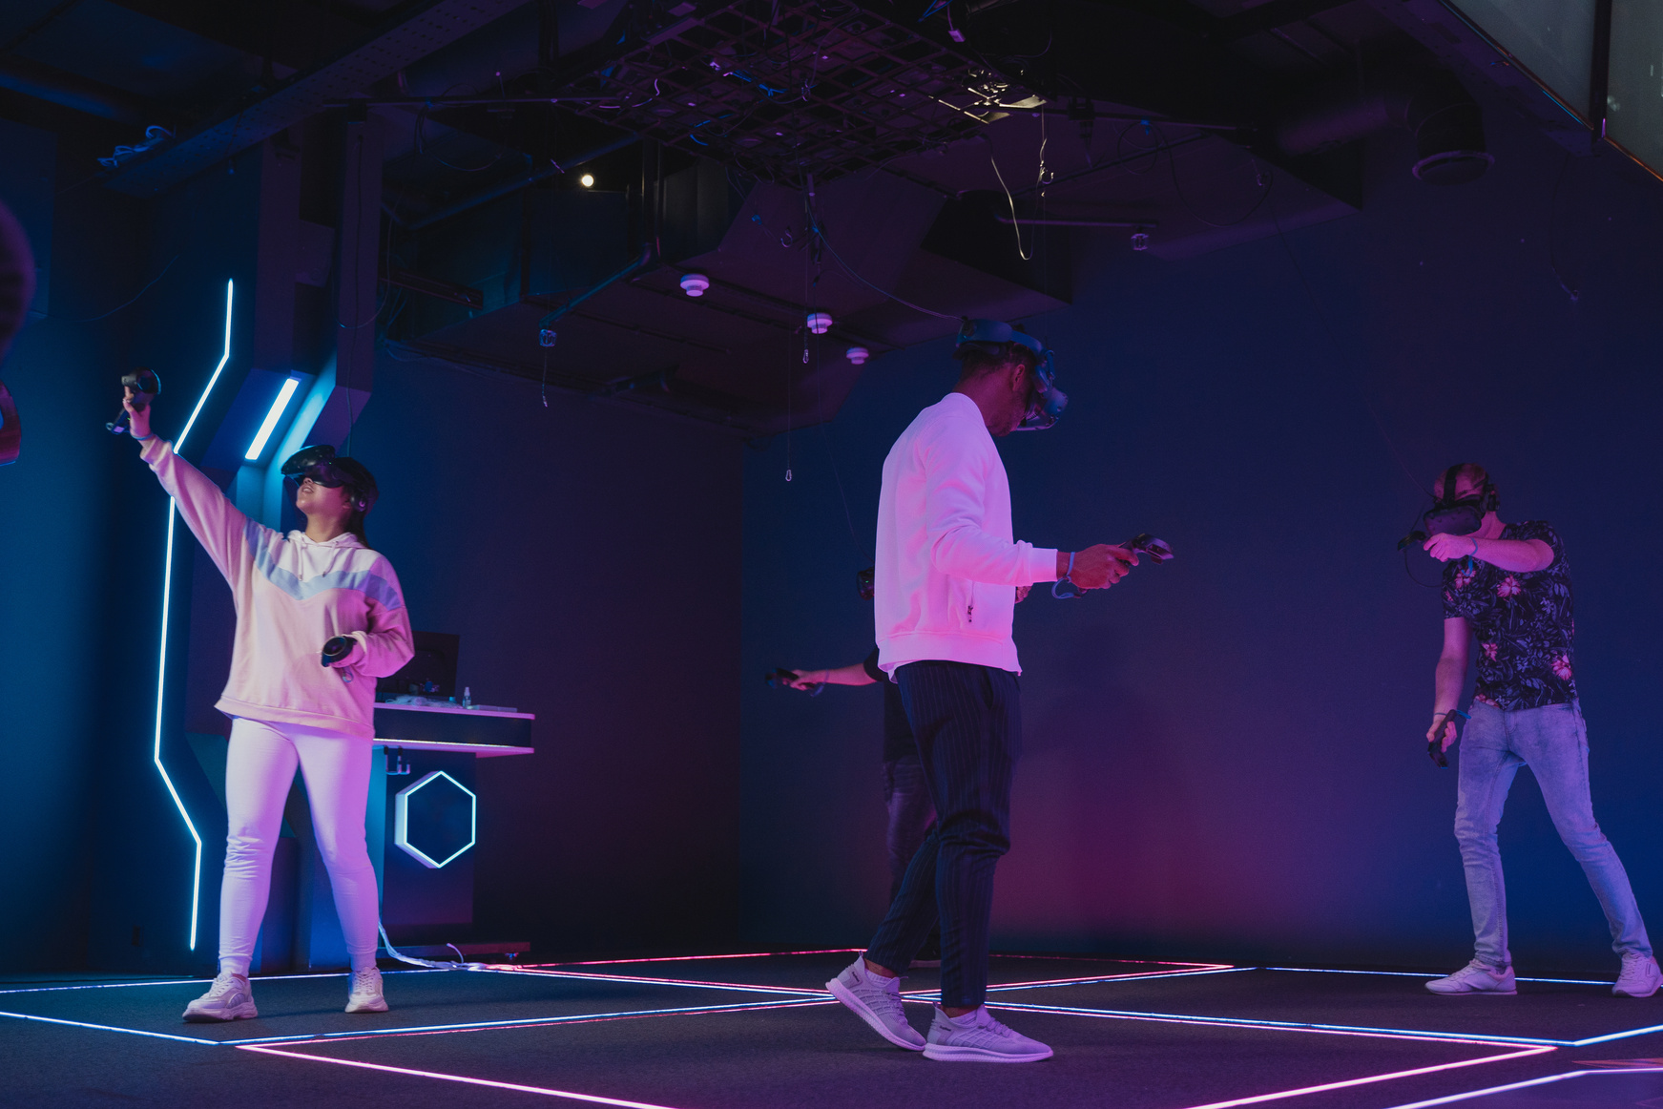


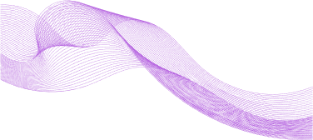
Over 2.5 million research publications annually
Published in more than 30,000 peer-reviewed journals
8.854 million FTE researchers
P 1
Sifting through vast resources to find relevant, high quality papers can be time consuming.
PROBLEM STATEMENT
P 2
New researchers often face difficulties with formatting and grammatical correctness, which can result in manuscript rejection
P 3
Existing search engines often lack personalized recommendation features, making it challenging to efficiently find the most relevant and high-quality papers.

Slide 4



VISION & MISSION
VISION: Create a comprehensive platform to streamline and enhance the research process.
MISSION:
Personalized Paper Recommendations: Contextual search for relevant papers.
Paper Review Service: Detailed summaries beyond abstract limitations.
Paper Writing Service: Dedicated platform for drafting and formatting papers.
Researcher Connectivity: Blog page for idea sharing and collaboration.

Slide 5
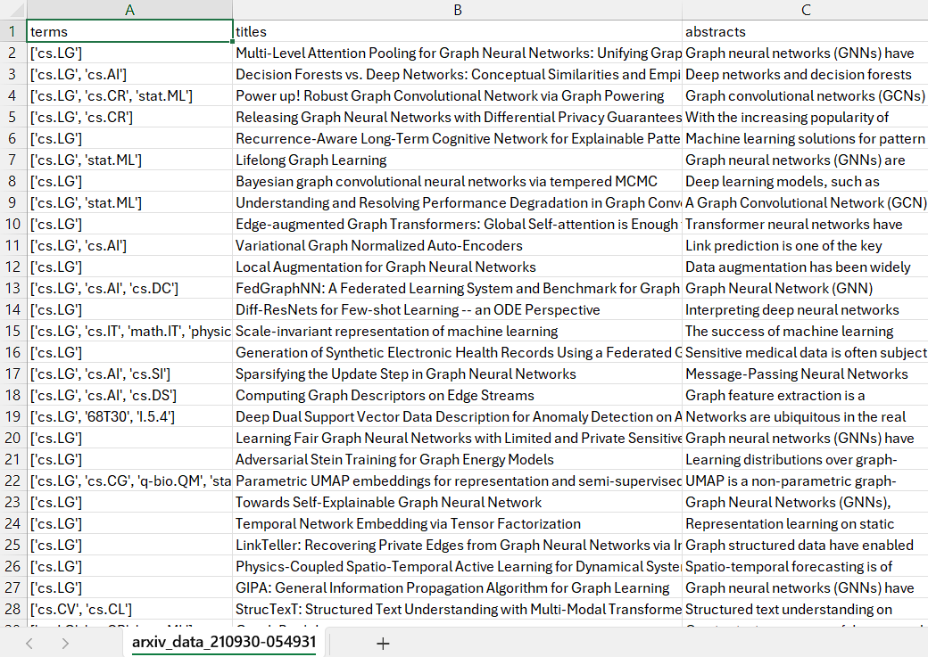
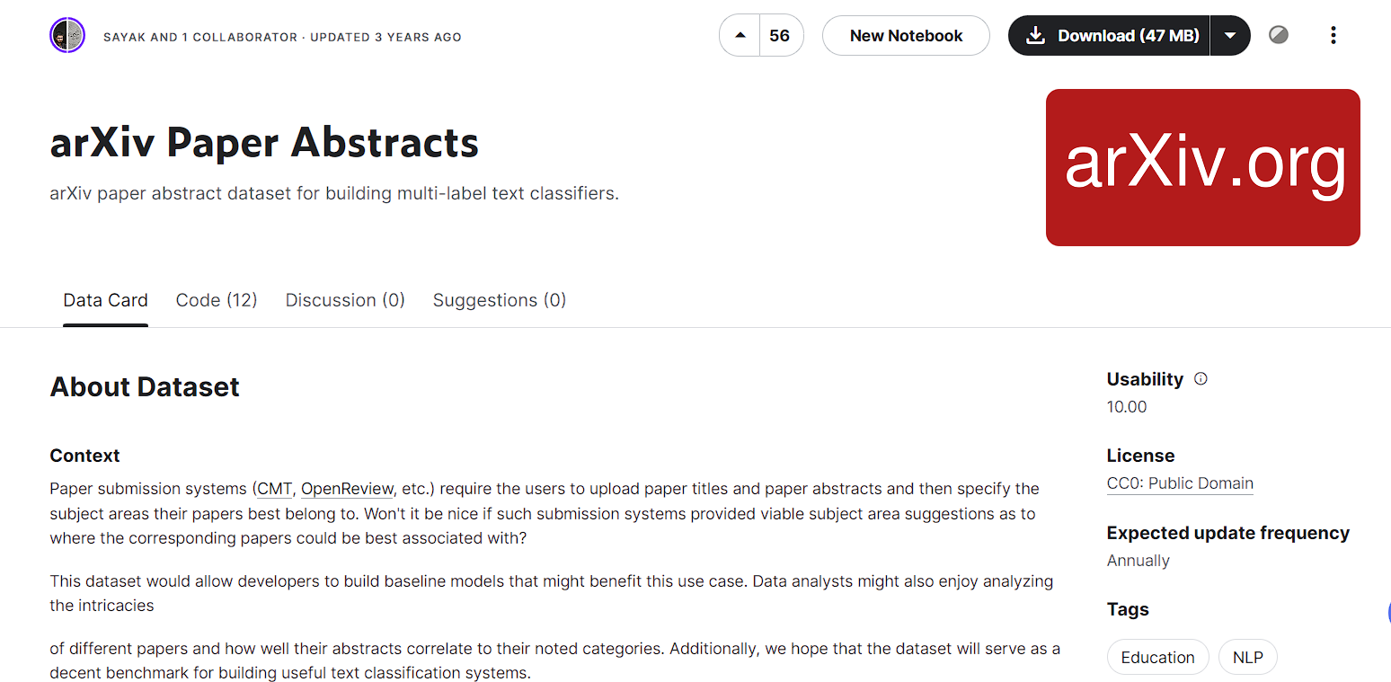
PROPOSED SOLUTION
DATASET:
This proposed solution addresses two primary objectives using the 'arxiv paper abstract' dataset from Kaggle.
Read More

Slide 6
PROJECT OVERVIEW
SECTION 1: RECOMMENDATION SYSTEM
SECTION 2: SUBJECT AREA PREDICTION MODEL
DATA PREPARATION
PROJECT
SENTENCE EMBEDDINGS
TEXT VECTORIZATION
COSINE SIMILARITY
MODEL DEVELOPMENT

Slide 7


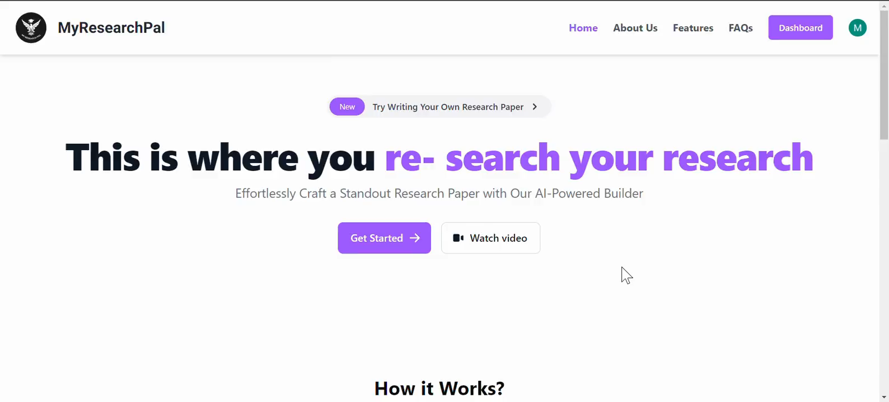
IMPLEMENTATION

Slide 8

BUSINESS MODEL
Freemium Model
Offer basic features such as search, recommendations, and subject area prediction for free for a limited usage period.
Subscription Plans
Provide premium features like advanced search filters, citation management, collaboration tools, and priority customer support for a subscription fee.
Partnerships
Collaborate with academic institutions, publishers, and research organizations to offer customized solutions and generate revenue through licensing and data sharing.

Slide 9
D
Citations and Reference Mapping
- Implement features for automatic citations and reference mapping to streamline the research documentation process
Enhanced Collaboration Tools
- Introduce features for real-time collaboration, allowing multiple researchers to work on a document simultaneously.
Graph and Shape Interface
- Develop a user-friendly interface for creating graphs and shapes, simplifying tasks for researchers compared to Excel
C
Perplexity Chat Bot Integration
- Incorporate a paid Perplexity Chat Bot for enhanced research assistance.
FUTURE RECOMMENDATIONS
B
A

Slide 10



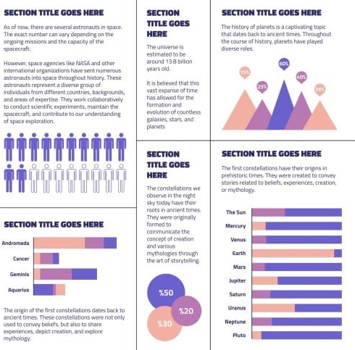

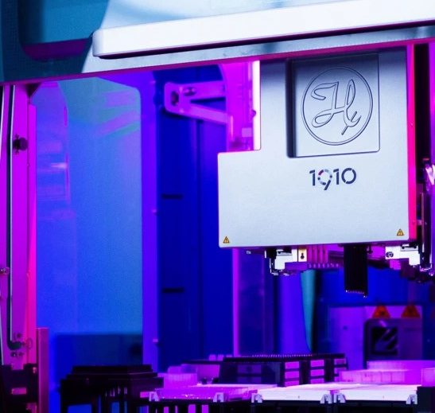
USERS
POLICY MAKERS
LIBRARIES AND INFORMATION SERVICES
GRADUATE AND POSTGRADUATE STUDENTS
ACADEMIC RESEARCHERS
EDUCATORS AND PROFESSORS
INDUSTRY RESEARCHERS AND R&D TEAMS

Slide 11
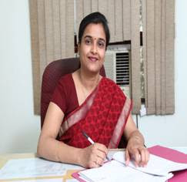


Lets hear from a user
Mrs. Vasudha Tiwari, mother of Bhavya Tiwari

Slide 12
THANK YOU
FOR YOUR ATTENTION

